Slide 1

Exploratory Data Analysis
XYZ Cab Market Analysis & Investment Recommendation
21/06/2025
ASHWINIBN3@ICLOUD.COM LISUM46
ASHWINI B N

Slide 2
Agenda
Business Problem and Objective
Data Sources and Methodology
Hypothesis Insights
Hypothesis Summary
Predictive Model: Profit Estimation
Final Recommendation

Slide 3
Business Problem:
XYZ plans to invest in the fast-growing US cab industry
Needs to choose between Yellow Cab and Pink Cab
Objective:
Analyze cab operations, customer behavior, and profit trends
Deliver a data-backed recommendation to support XYZ’s investment decision

Slide 4
Data Sources & Methodology
Data Sources
Cab Data: Trip-level details for Yellow & Pink Cab
Customer Data: Age, gender, income
Transaction Data: Payment mode and customer mapping
City Data: Population and cab usage trends
Time Period: Jan 2016 – Dec 2018
Methodology
Combined and cleaned all data sets
Analyzed ride volume, profit trends, and customer segments
Built a simple model to predict profit per trip
Extracted business insights to support XYZ’s investment decision

Slide 5
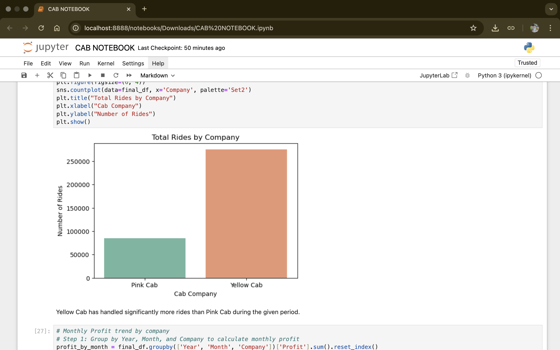
Hypothesis Insights Key Insight 1: Ride Volume by company(H1)
Yellow Cab has significantly more rides than Pink Cab.
It handled nearly 3x more trips from 2016–2018.
Indicates stronger market presence and customer base.
Hypothesis Result: Supported

Slide 6
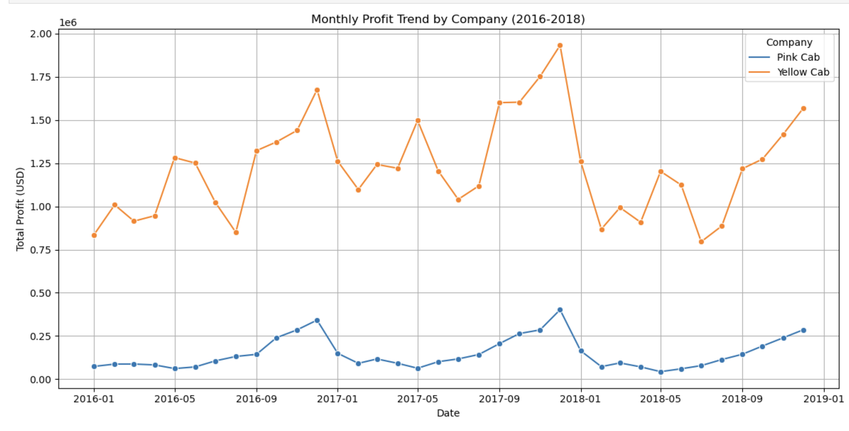
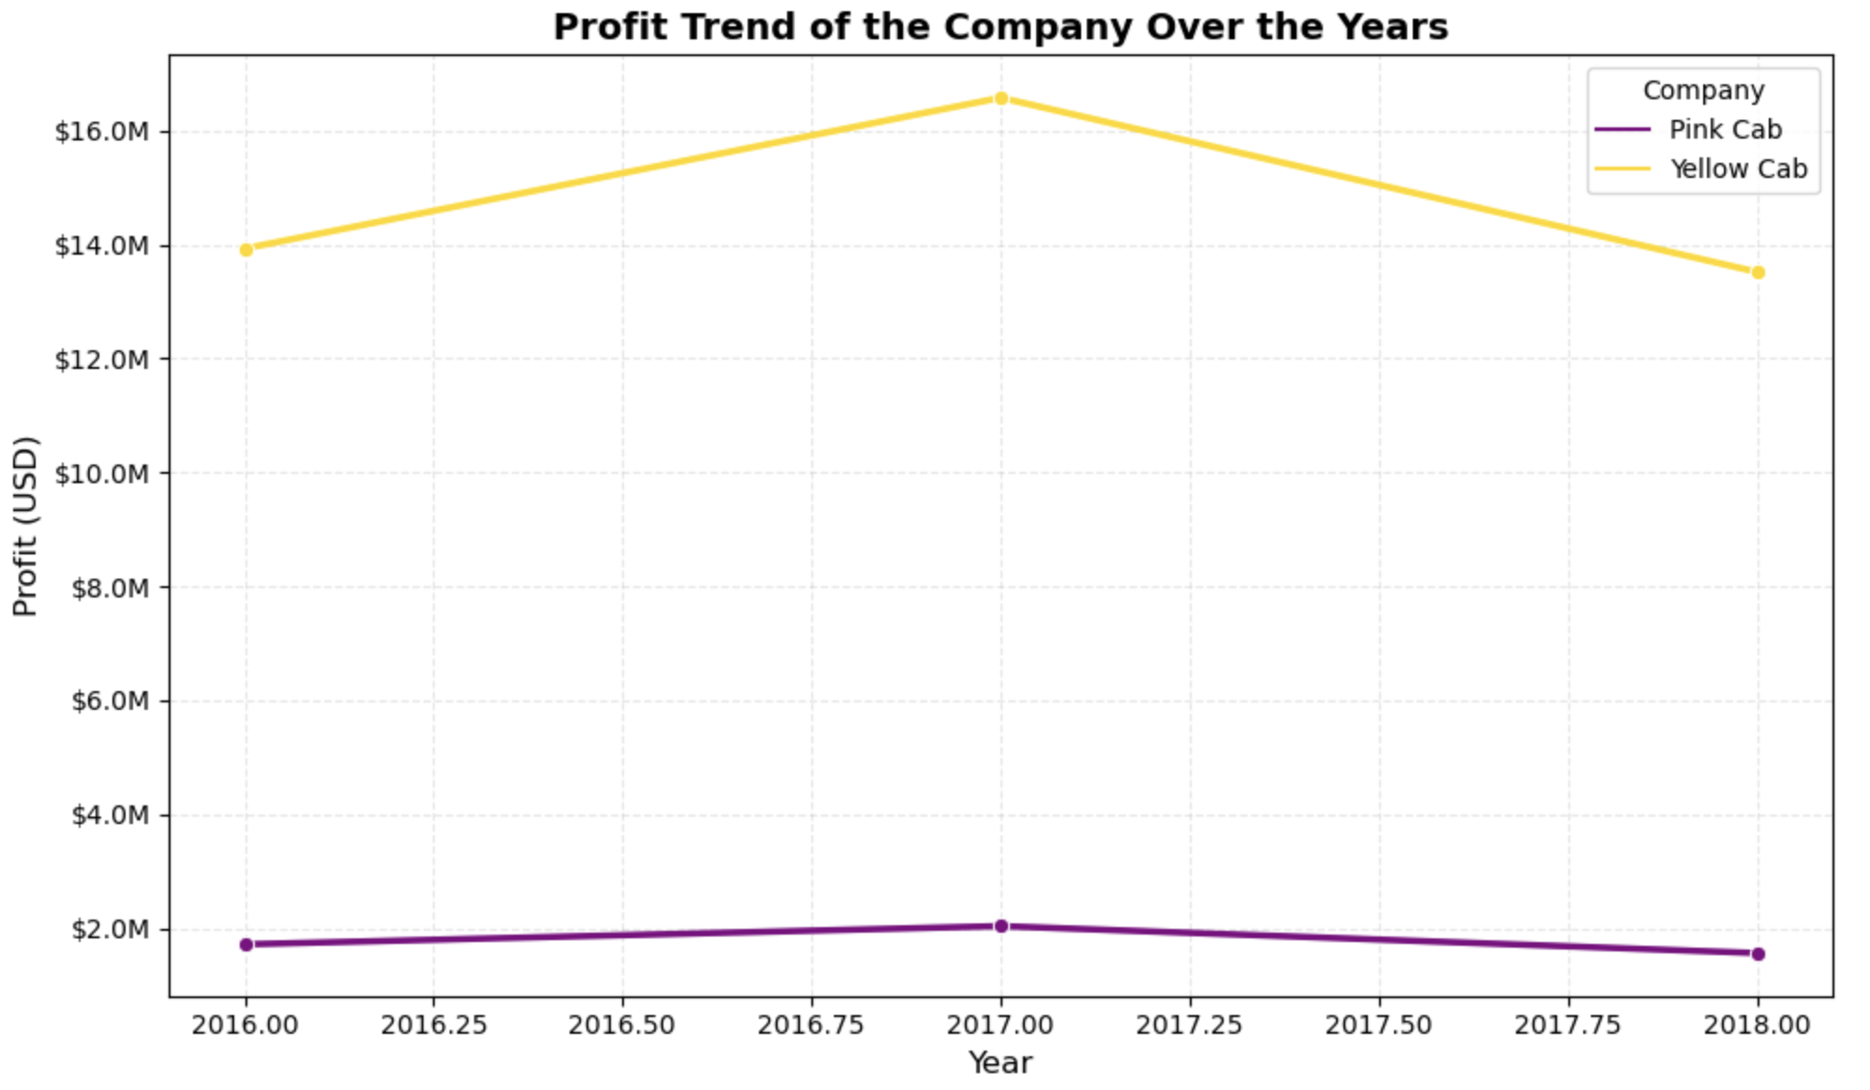
Key Insight 2: Profitability Trends(H2)
Yellow Cab consistently outperforms Pink Cab in monthly profits.
Profit spikes match with high ride months — especially year-end.
Confirms that ride volume contributes directly to higher profit.
Hypothesis Result: Supported

Slide 7
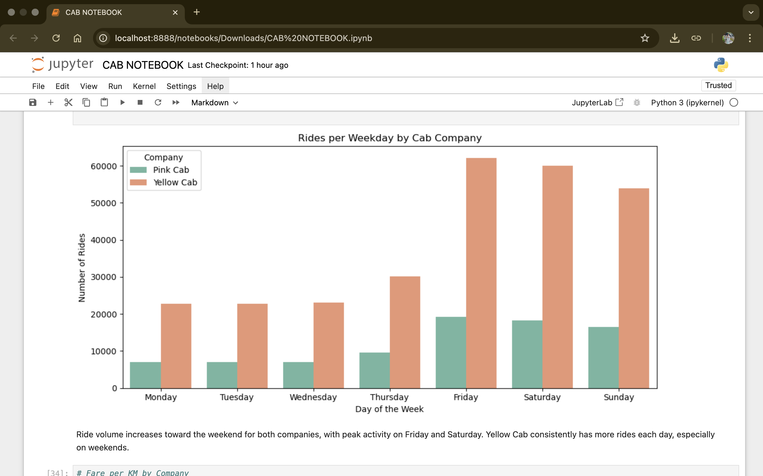
Key Insight 3: Seasonality in Usage(H3)
Ride volume peaks on Fridays and Saturdays for both companies.
Yellow Cab consistently leads in ride volume across all days.
Strong evidence of weekend usage pattern.
Hypothesis Result: Supported

Slide 8
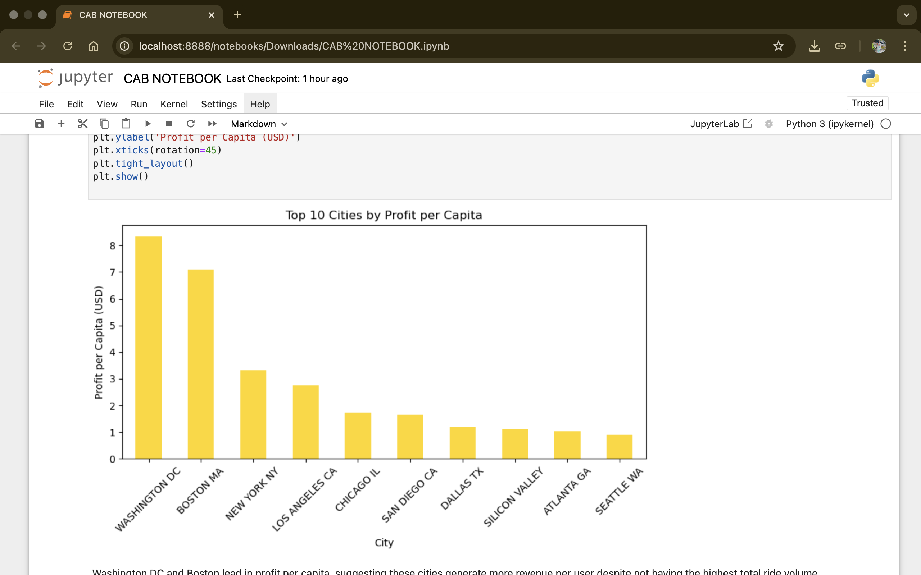
Key Insight 4: City level Profitability (H4)
Cities like Washington DC and Boston have the highest profit per user.
These cities aren’t just busy — they are efficient revenue generators.s
Helps XYZ focus investment in high-margin urban markets.
Hypothesis Result : Supported

Slide 9
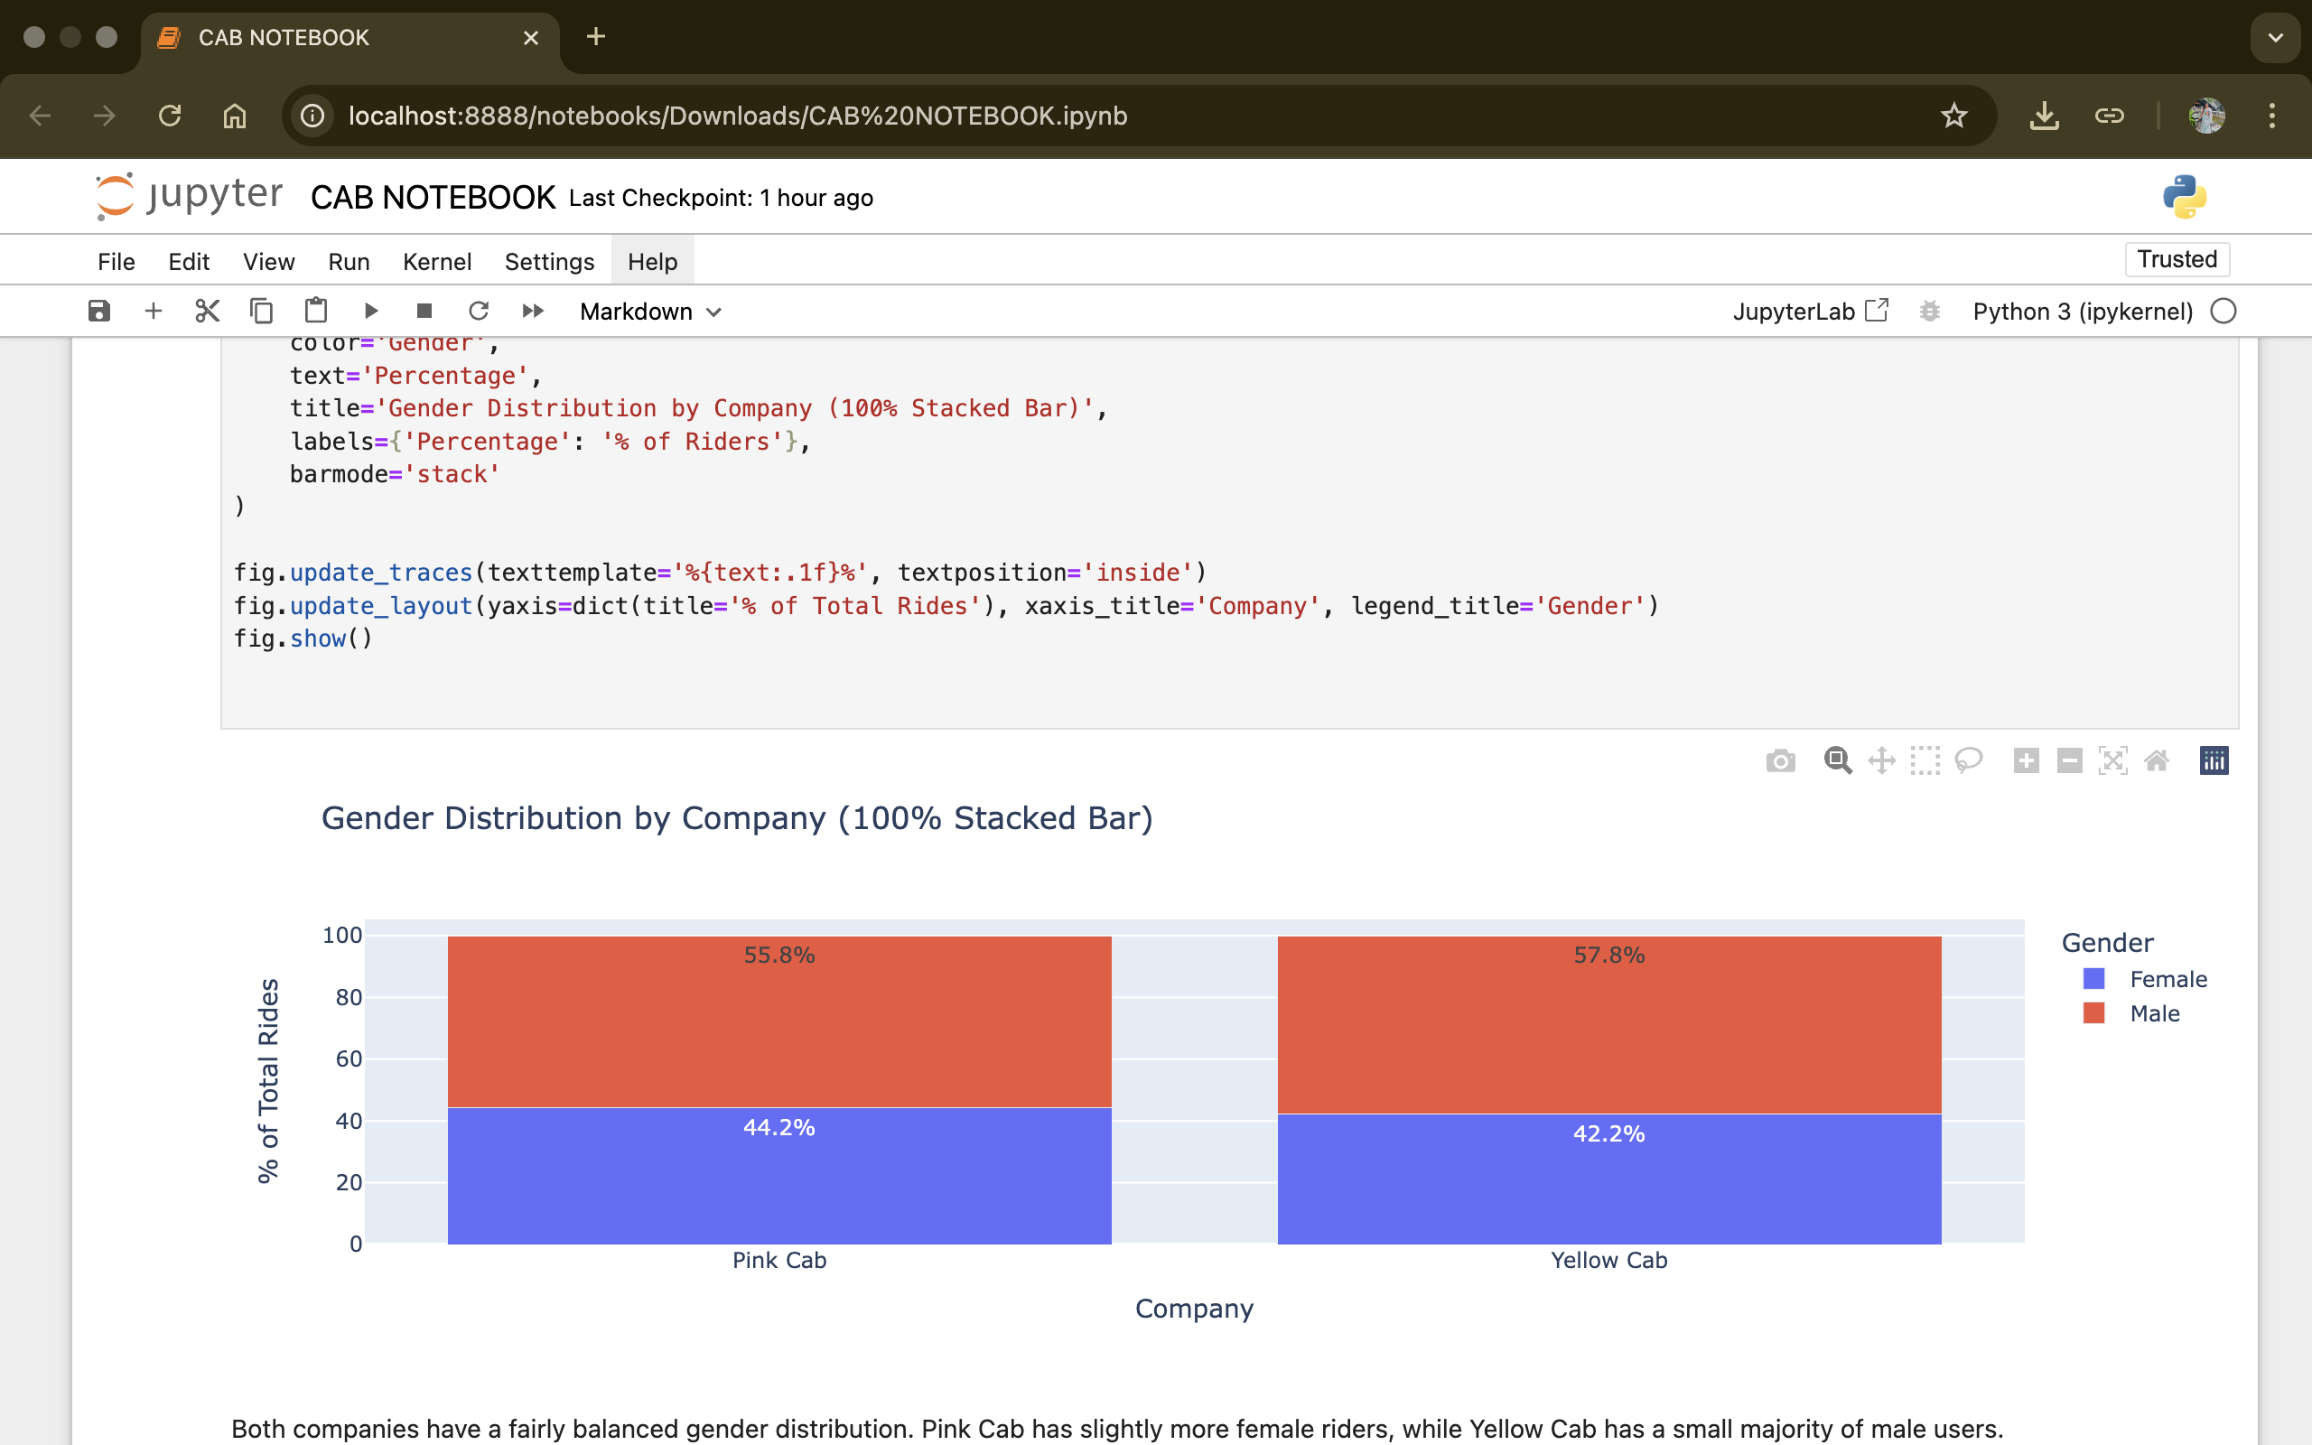
Key Insight 5: Gender Distribution(H5)
Pink Cab has a slightly higher share of female riders (44.2%)
Yellow Cab shows a small male majority
Gender split is similar but not fully balanced
May inform gender-focused marketing strategies.
Hypothesis Result: Partially Supported

Slide 10
Hypothesis Summary
Hypothesis | Supported? | Key Insight
H1: Yellow Cab has more users than Pink Cab | ✅ Yes | Yellow Cab has 3× the rides — stronger market share
H2: More users lead to more profit | ✅ Yes | Higher ride volume directly links to higher monthly profits
H3: Seasonal and weekly ride spikes exist | ✅ Yes | Fridays, Saturdays, and holidays show peak ride activity
H6: Some cities are more profitable per capita | ✅ Yes | Cities like DC and Boston lead in profit per user
H7: Gender and income are balanced | ⚠️ Partially Supported | Pink Cab has slightly more female riders

Slide 11
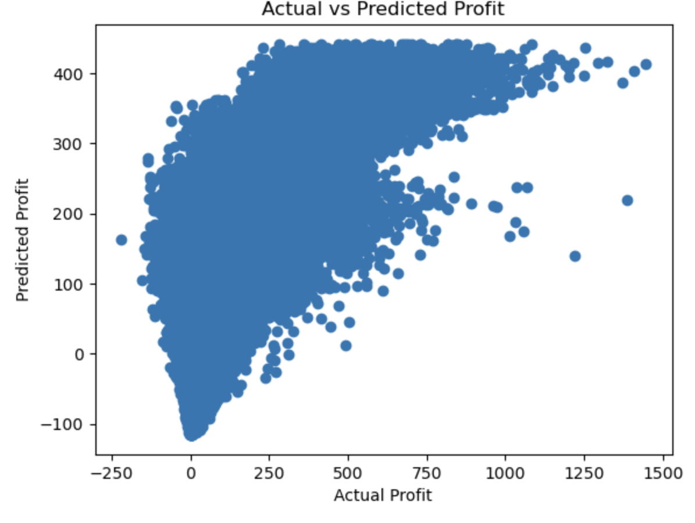
Predictive model: Profit Estimation
Built a Linear Regression model to predict profit per trip
Input features: KM travelled, population, income, and company type
Model Performance:
R² Score: 0.55 – explains 55% of profit variation
MSE: 11,717
Longer trips, high-income users, and Yellow Cab trips generate higher profit
The model predictions follow actual profit values reasonably well. Most points cluster along the expected trend

Slide 12
Final Recommendation
Yellow Cab consistently outperforms Pink Cab across all key metrics:
3× higher ride volume
Higher monthly and yearly profit
Broader customer age reach
More profitable in major cities like DC and Boston
Predictive model confirms Yellow Cab trips are more profitable
Stronger presence across weekdays, weekends, and holidays
Recommendation: XYZ should invest in Yellow Cab for its established market presence, better margins, and higher profitability potential

Slide 13
Thank You

